Slide 1
ReinForcement Learning
FrozenLake
박민재

Slide 2
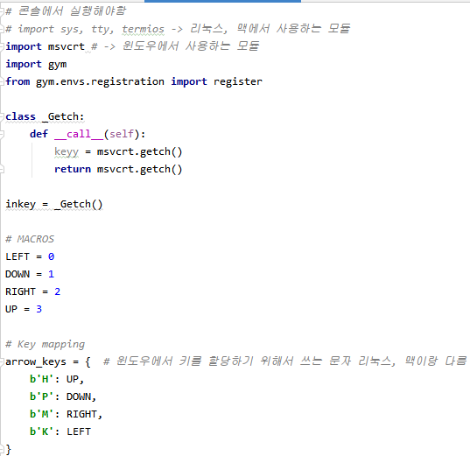
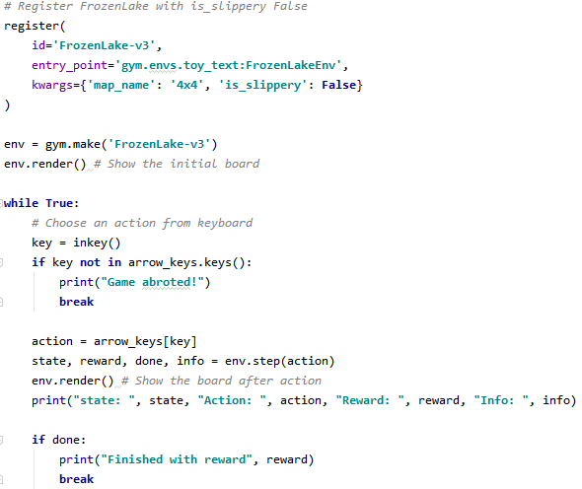
FrozenLake-keyboard

Slide 3
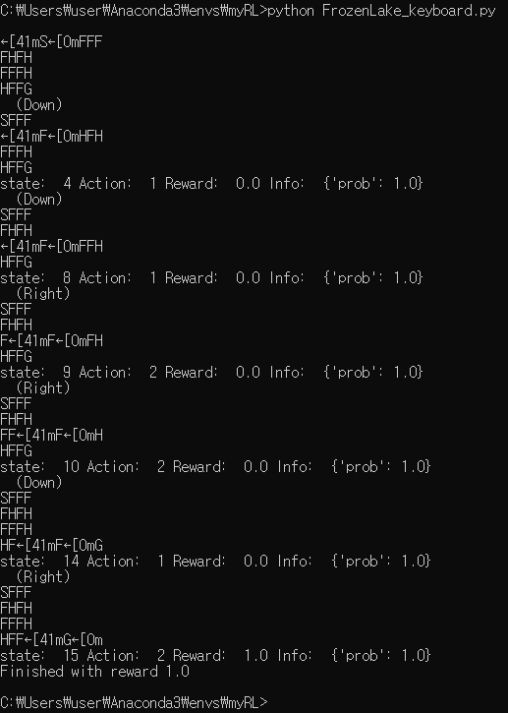
FrozenLake-keyboard

Slide 4
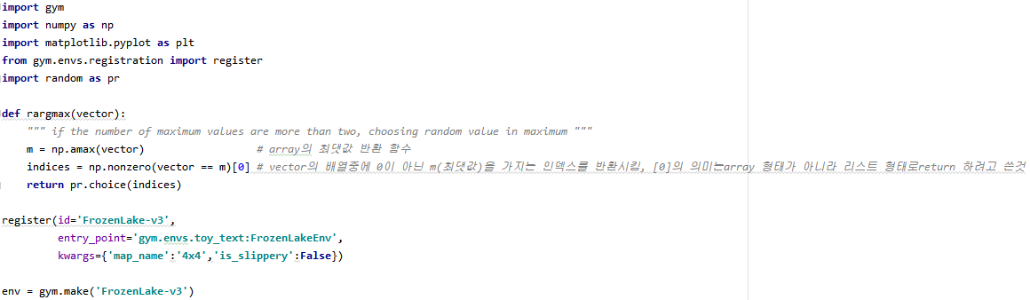
FrozenLake-Q Learning

Slide 5
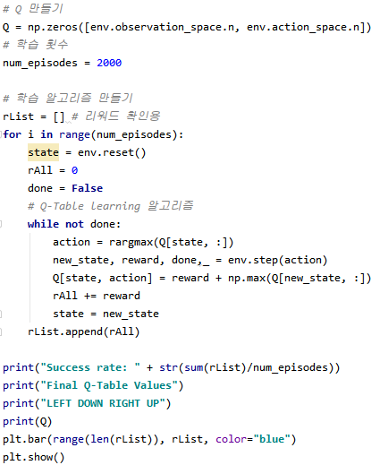
FrozenLake-Q Learning

Slide 6
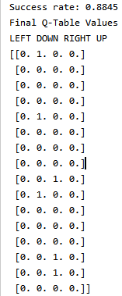
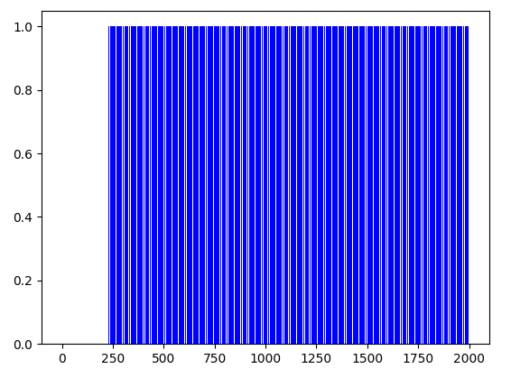
FrozenLake-Q Learning

